Slide 1
Hr Data Analytics Dashboards
HR analytics helps HR professionals make data-based decisions that play a pivotal role in an organization’s success. This Dashboards helps for futuristic decision.
Submitted by Parvathavardini Murugan

Slide 2


Excel Data Cleaning

Slide 3
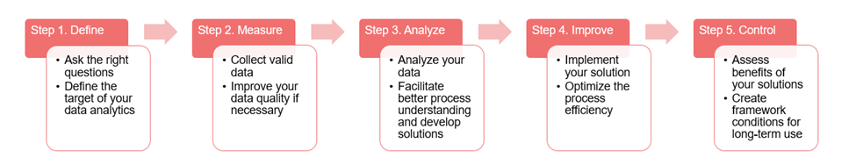
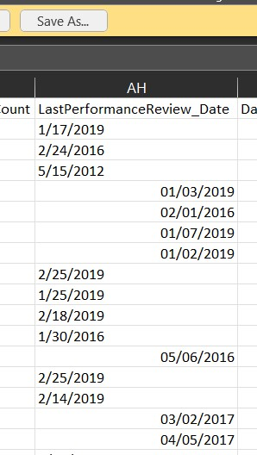
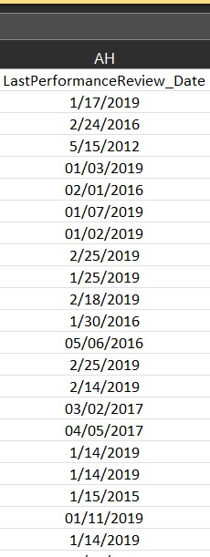
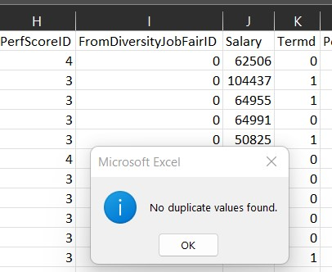
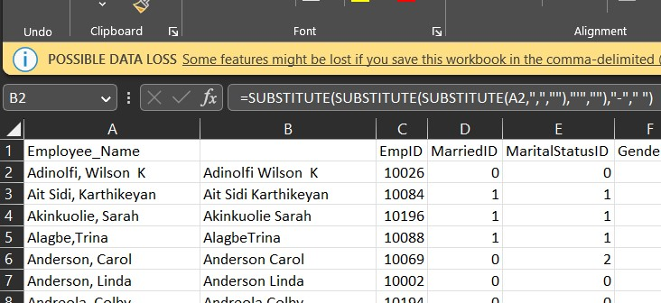
Data Analysis Process Step by Step:
1.Checked The Alignments:
2.Checked for the Duplicates:
3.Removed Special Characters:

Slide 4
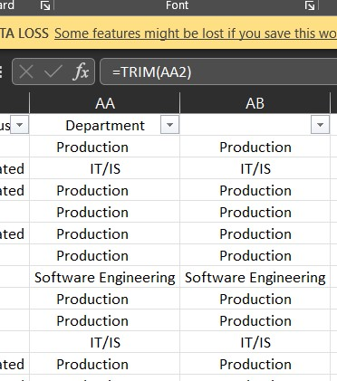
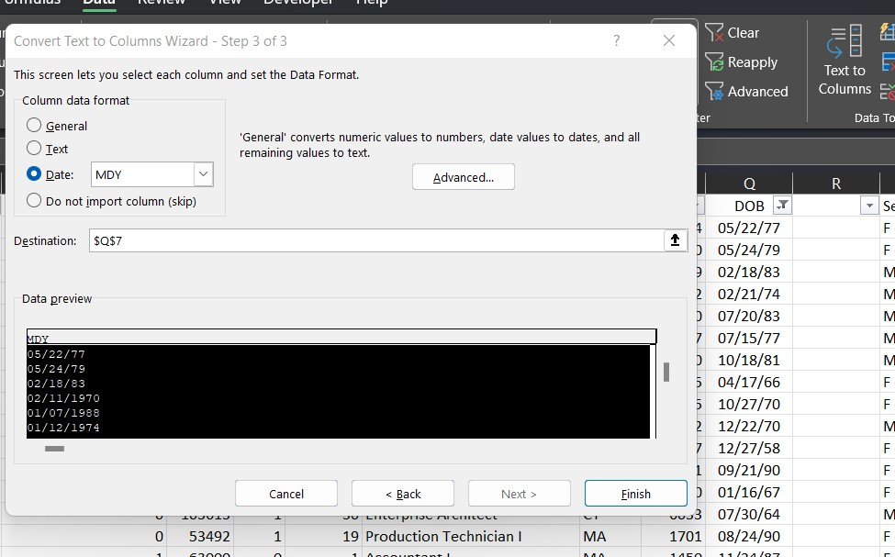
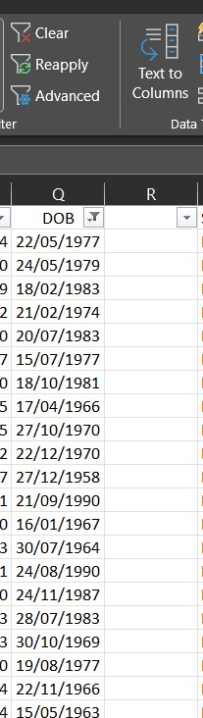
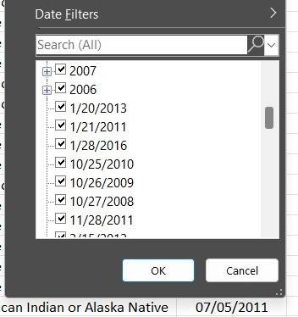
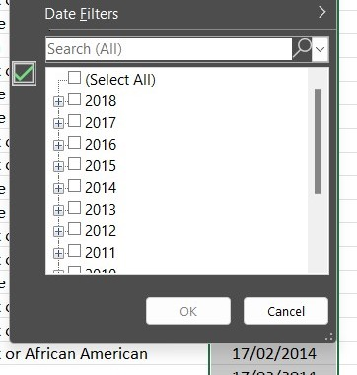
4.Trimmed extra spaces:
5.Formatted text to Date:

Slide 5
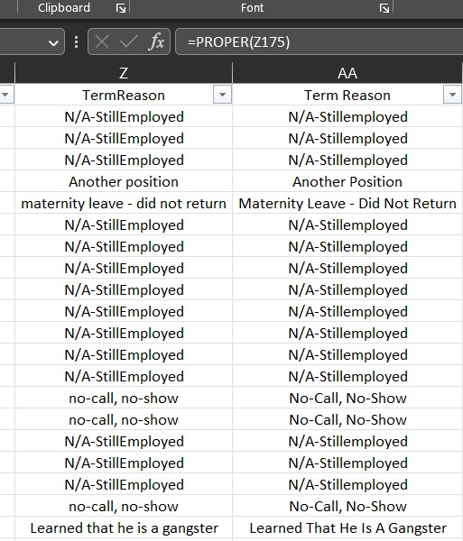
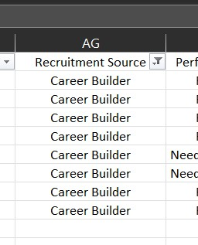
6.Formatted text to Proper style:
Formulas used in Excel:
Substitute
Trim
Proper

Slide 6

Power Query in Bi

Slide 7
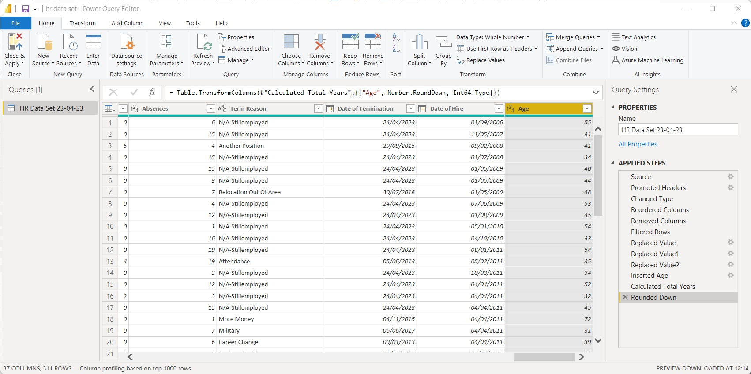
1.Added new column for Current Age for each employee:

Slide 8
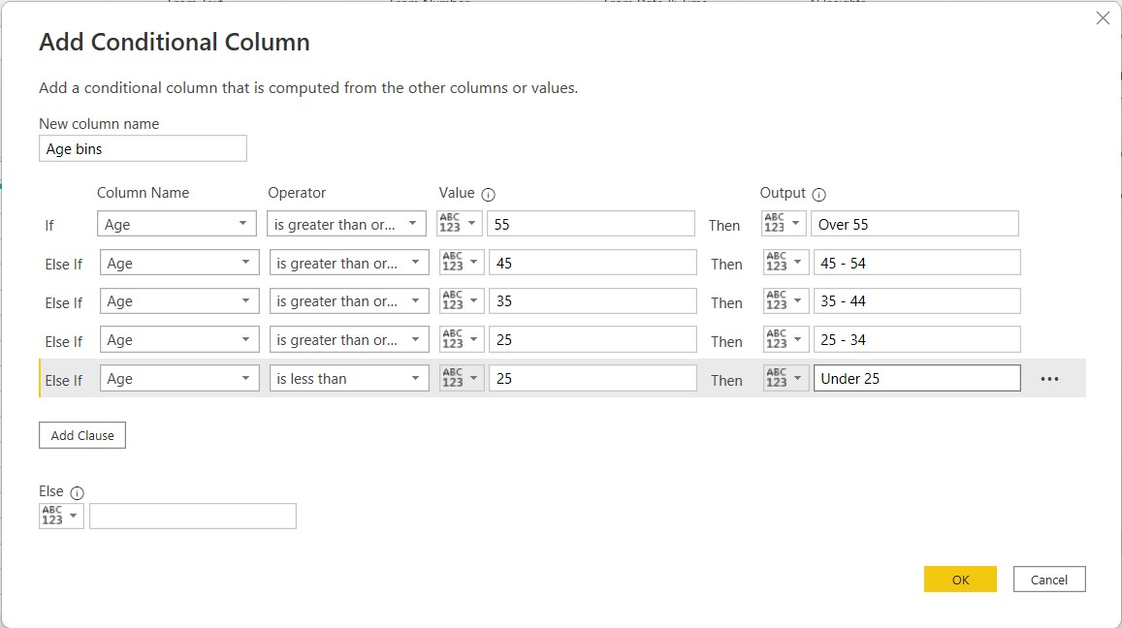
1.Added Conditional column with Age Bands:

Slide 9
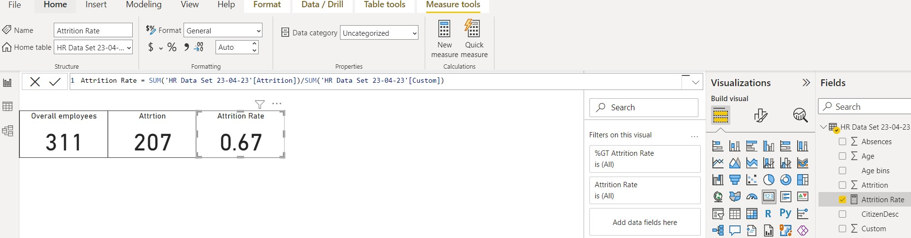
3.Dax Formulas Used to show each KPI’S

Slide 10
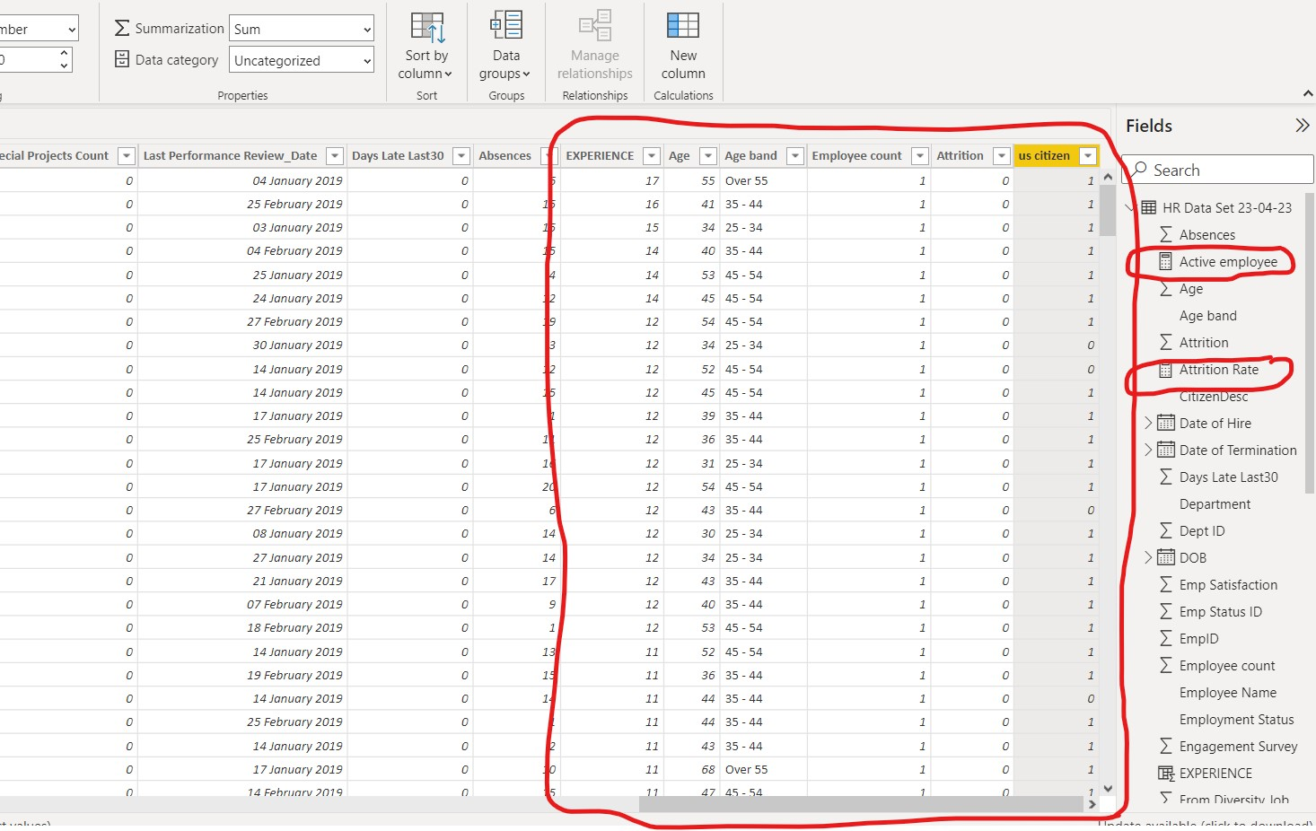
3.Created new columns and new measures for the Dashboards:

Slide 11
Power Bi Dashboards

Slide 12
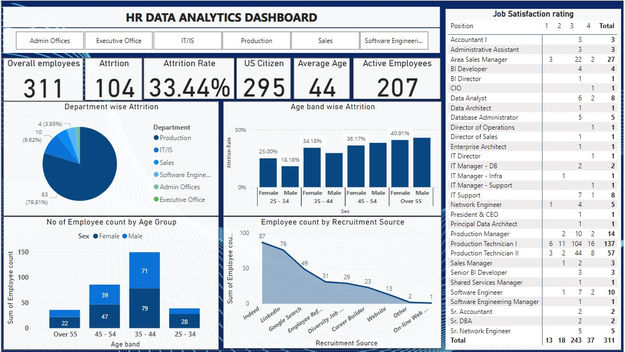

Slide 13
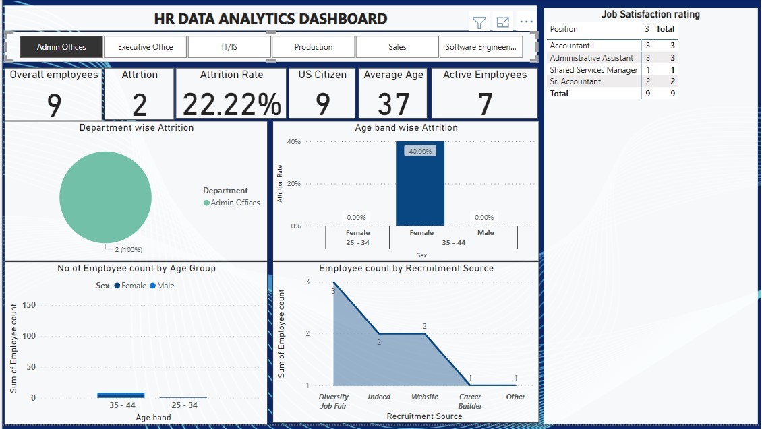

Slide 14
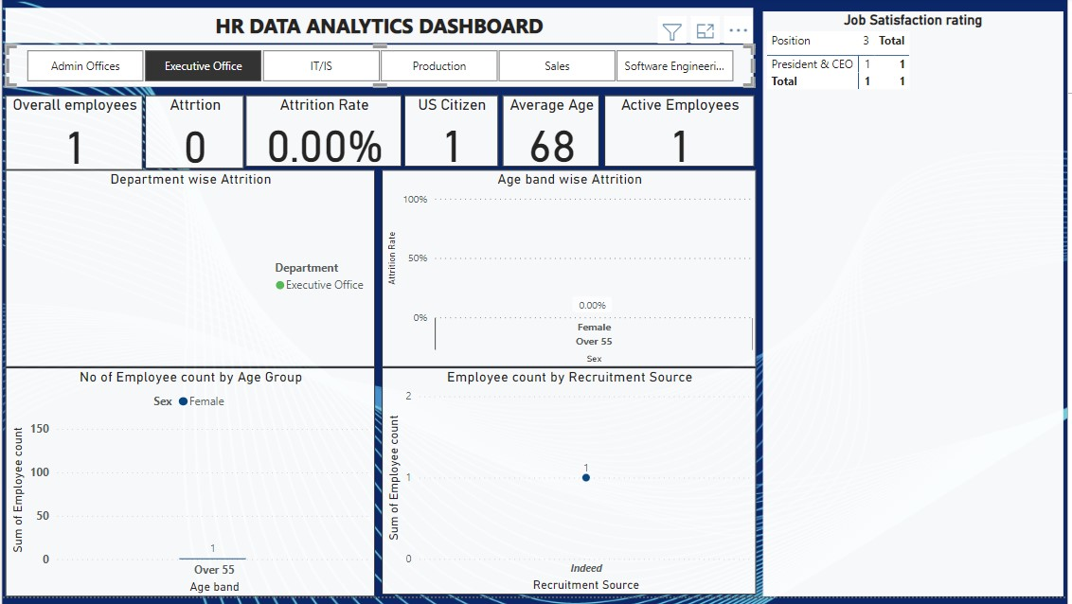

Slide 15
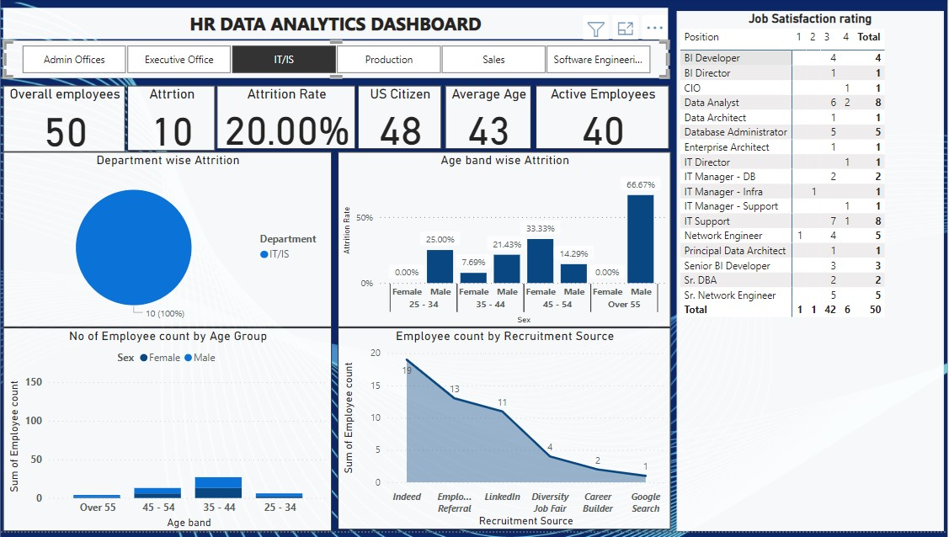

Slide 16
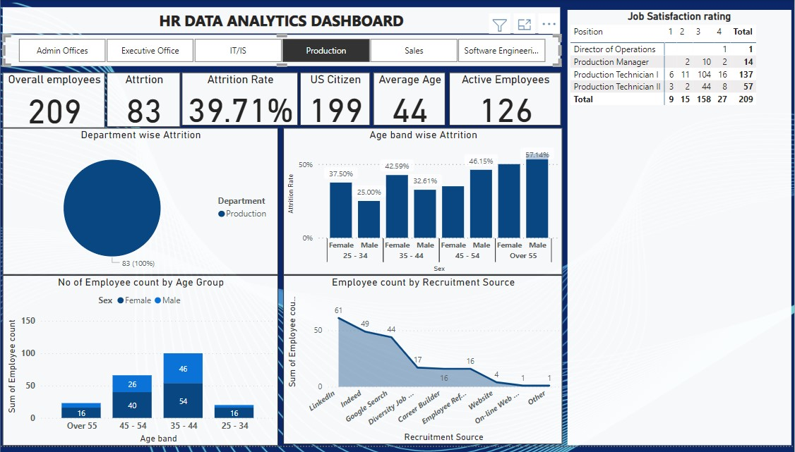

Slide 17
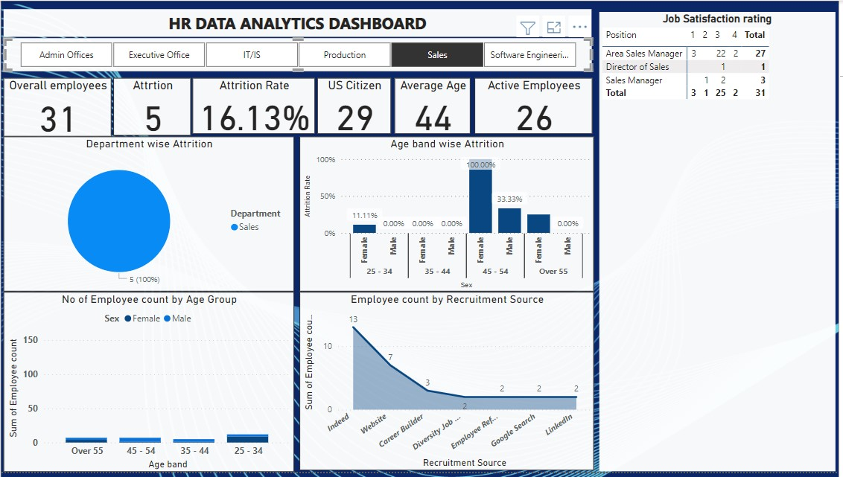

Slide 18
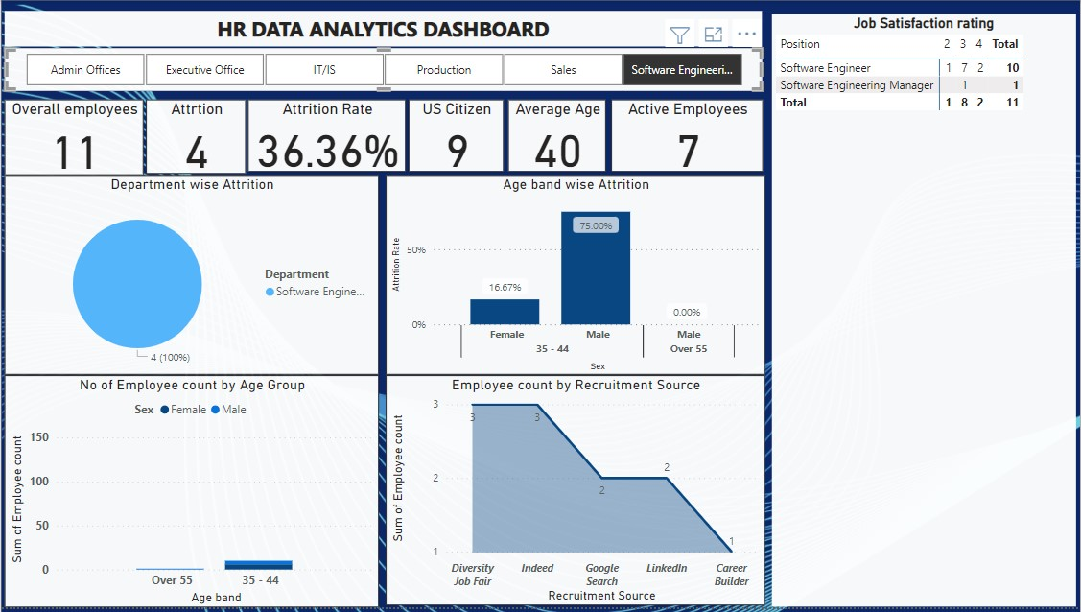

Slide 19
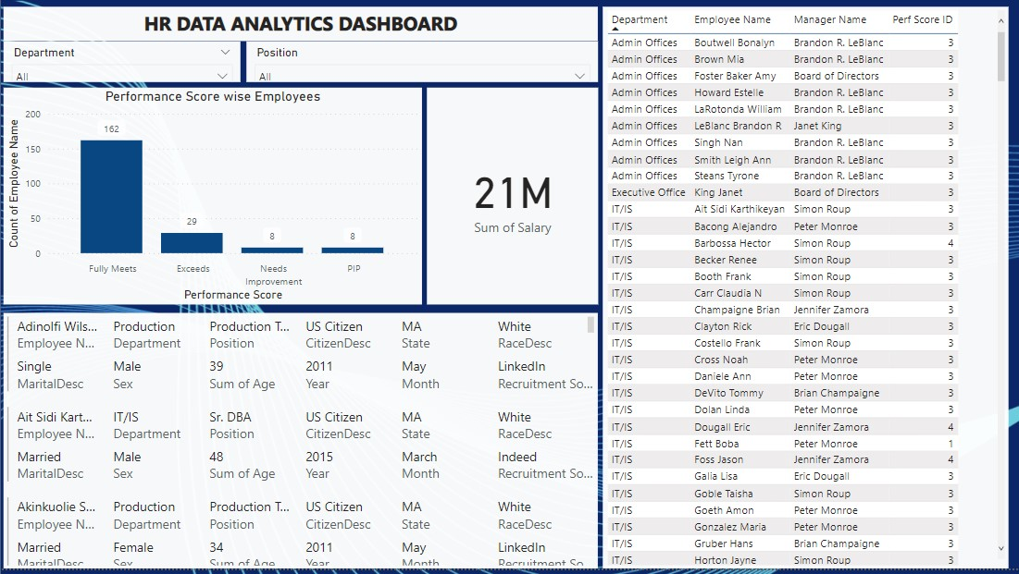

Slide 20
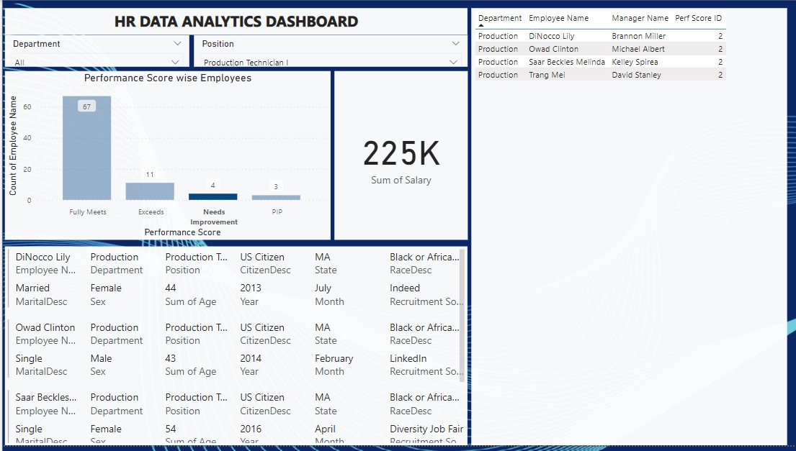

Slide 21
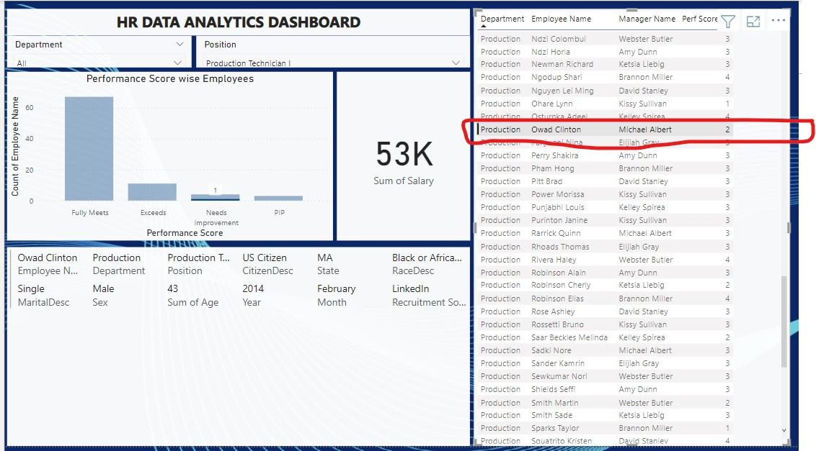

Slide 23
Thanks for the Opportunity

